Slide 1
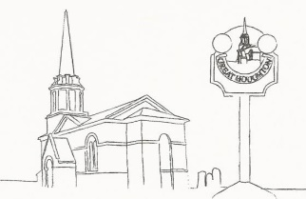
Great Houghton Parish Council
Have you ever thought about becoming a Councillor?

Slide 2
Great Houghton Parish Council Current Councillors
Chairman - Bill Garner
Vice Chair - Rod Jeakings GHPFA, DSAG, ICM
Councillor Rosemary Shaw PAG
Councillor Vanessa Williams PAG
Councillor Mike Barham Police Liaison Representative
Councillor Paul Wright
Parish Clerk Mike Billingham
We currently have a vacancy for another Councillor

Slide 3
What is a Parish Council
A democratically elected body established by legislation
The first tier of local government
Statutory powers to provide benefits and services that will make a difference to its community
Statutory Power to precept (tax) local electors to fund activities
Consultative body on all Planning Applications

Slide 4
What is the role of a Parish Councillor
Holder of a Public Office (not a volunteer)
To participate in collective council decision making (no authority to make independent decisions)
Term of Office is for four years
Summonsed to attend Council meetings
To ensure that rate payers money is spent correctly and appropriately
To safeguard environment and cultural heritage

Slide 5
What Commitment is required of a Parish Councillor
To attend council meetings held every second Tuesday of each month (limited to 2.5 hours)
To be 18 years of age and have lived or worked in Parish for 12 months
May choose to participate in additional committees or groups
Must complete ‘Declaration of Interests’ registered with Principle Borough Council

